Slide 1

SCOTTISH PREMIERSHIP
2026–27
New managers. New players. A promoted contender.
SEASON BRIEFING | CONFIRMED CHANGES AS OF 18 AUGUST 2026
Notes:
Welcome to the 2026-27 Scottish Premiership briefing. We are looking at confirmed changes as of mid-August, and the landscape is shifting fast. Let us dive right into what is driving the new campaign.

Slide 2

A LEAGUE IN TRANSITION
12 clubs begin a season shaped by leadership and squad renewal.
Celtic enter as champions after a final-day title win last season.
St Johnstone are the only promoted side; Livingston have been relegated.
More than 80 arrivals had already been recorded before the season’s opening weekend, with the window still open until 3 September.
Notes:
The league is not simply restarting this season; it is resetting entirely. We have twelve clubs navigating heavy squad turnover and major dugout shifts. Over eighty arrivals landed before the opening weekend alone, and the transfer window is still open. And now we turn to the lone newcomer stepping into this high-tempo environment.

Slide 3
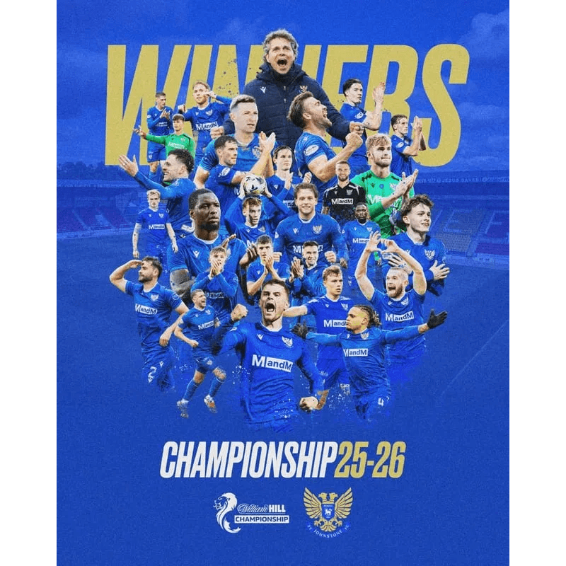
ST JOHNSTONE: BACK IN THE TOP FLIGHT
Returned to the Premiership after one season away.
The sole promoted club for 2026–27; St Mirren retained top-flight status through the play-offs.
The immediate assignment is clear: convert Championship momentum into Premiership resilience.
Their summer intake combines experience, loans and attacking depth.
Notes:
St Johnstone are back in the top flight after just one season away. They face a familiar challenge in converting Championship momentum into sheer Premiership resilience. Their summer recruitment blends experience with attacking loans to survive the step up. Let us look at how the dugout dynamics across the division are shifting alongside these squad changes.

Slide 4

FOUR NEW LEADERSHIP NARRATIVES
CLUB
MANAGERIAL STORY
IMMEDIATE CONTEXT
The champions must sustain standards amid squad change.
Martin O’Neill
returns for a fourth spell.
Celtic
Derek McInnes
His remit is to turn recruitment into a title challenge.
is the fifth new manager in five seasons.
Rangers
Wouter Vrancken
Arrives after a final-day title loss.
succeeds McInnes.
Hearts
Alfred Johansson
At 35, the league’s youngest manager.
succeeds Jens Berthel Askou.
Motherwell
Notes:
The managerial landscape brings four completely distinct storylines to the table. We see restoration at Celtic, heavy pressure at Rangers, direct succession at Hearts, and youth at Motherwell. Each brings a different tactical weight to the campaign. And that brings us to the champions and their massive moves in the transfer market.

Slide 5
CELTIC MAKE A RECORD ATTACKING BET
Kasper Høgh joined from Bodø/Glimt in a club-record deal reported at £11m plus add-ons.
The Danish international is intended to replace outgoing forward Daizen Maeda.
Additional confirmed arrivals include Mika Baur, Camilo Duran and Haissem Hassan.
The champions have combined continuity in the title race with a material refresh up front.
Notes:
Celtic are making a heavy statement up front with a record-breaking deal for Kasper Høgh. He steps in to replace Daizen Maeda as part of a significant attacking refresh. The champions are clearly refusing to stand still while defending their crown.

Slide 6
RANGERS REBUILD AROUND A NEW SPINE
Lawrence Shankland and Cammy Devlin arrive from Hearts; Shankland is Rangers’ new captain.
Dan Neil (Sunderland) and Ross McCrorie (Bristol City) add midfield experience.
Derek McInnes inherits a transformed leadership group and a familiar core from his previous club.
The story is integration: a new manager, new captain and high-visibility arrivals all at once.

Slide 7

THE PROMOTED CLUB’S SURVIVAL TOOLKIT
Ruari Paton (Port Vale) and Matty Todd (Dunfermline Athletic) headline St Johnstone’s confirmed permanent additions.
Logan Chalmers (Partick Thistle) and Daniel Finlayson (Livingston) add domestic-league familiarity.
Zach Mitchell and Toby Steward arrive on loan, adding younger depth.
Recruitment is spread across attack, midfield, defence and goalkeeping rather than concentrated in one area.

Slide 8

CHANGE REACHES EVERY PART OF THE TABLE
CLUB
SELECTED CONFIRMED ARRIVALS
THE SIGNAL
Chris Cadden, Lewis Mayo, Connor Ronan
Broad multi-position refresh.
Aberdeen
Jason Kerr, Callum Wright, Nathan Lowe (loan)
Reinforcement through a mixed permanent-and-loan model.
Hibernian
Mark O’Hara, Bailey Rice (loan), Erik Ring
New options in midfield and wide areas.
Kilmarnock
Ismael Kabia (loan), Paul Nsio (loan), Luke Thomas
Targeted additions after play-off survival.
St Mirren

Slide 9
FOUR OPENING-SEASON WATCHPOINTS
New-manager adaptation: Can leadership changes produce early clarity and consistency?
High-profile integration: How quickly do Høgh, Shankland and other arrivals settle?
Promotion adjustment: Can St Johnstone translate a successful squad build into top-flight points?
Window effects: The transfer deadline remains 3 September at 17:00, so final squads are not yet fixed.

Slide 10
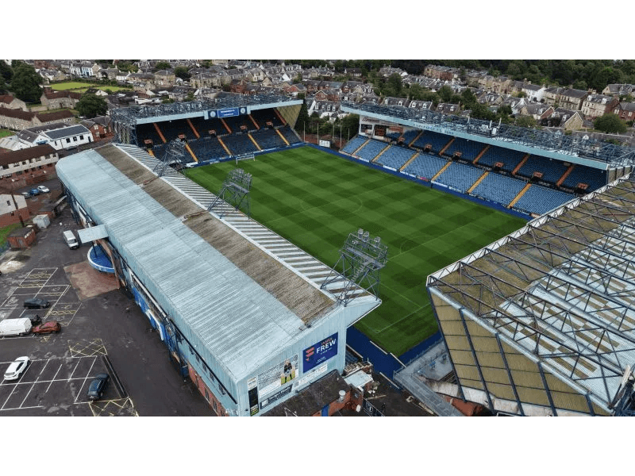
THE 2026–27 STORY STARTS WITH RENEWAL
One promoted club. Four major leadership narratives. A summer market still in motion.
TAKEAWAY: The Scottish Premiership begins with a clear competition theme: clubs are rebuilding identities as well as squads.
SOURCES
[1] Sky Sports, Scottish Premiership 2026/27: New season A–Z guide, 29 July 2026.
[2] SPFL, William Hill Premiership Transfers: Summer 2026, updated transfer list; deadline stated as 3 September 2026.

