Slide 1
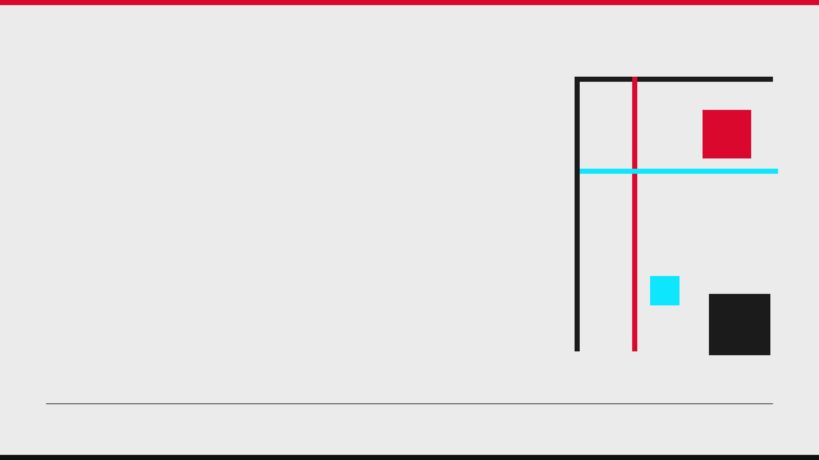
PREMIER LEAGUE BRIEFING
2026/27
THE CHANGE LOG
Promoted clubs • new managers • defining player movement
VERIFIED CHANGES ONLY
SNAPSHOT: 18 AUG 2026

Slide 2
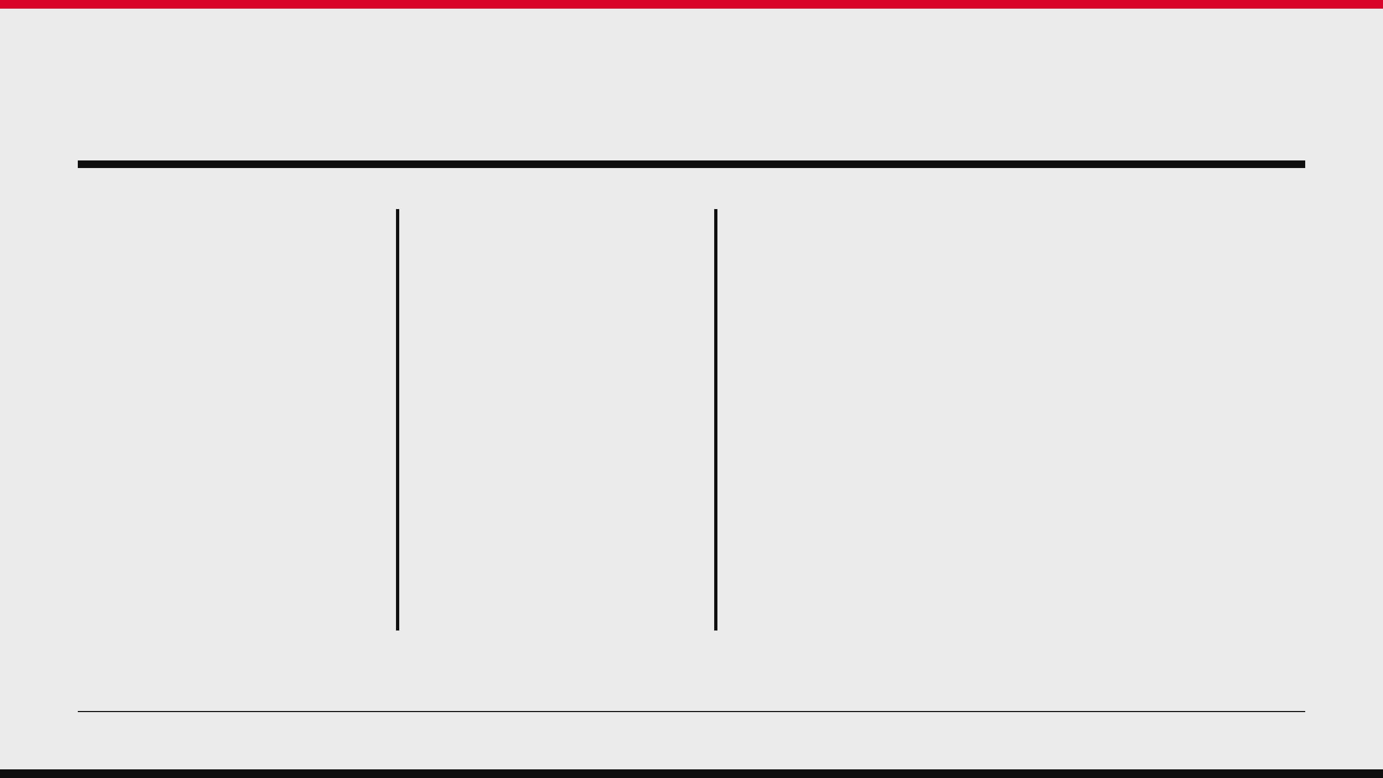
01 / SEASON RESET
THREE FORCES ARE RESHAPING THE LEAGUE
3
9
CORE
PROMOTED CLUBS
NEW MANAGERS
TALENT MOVED
Coventry City, Ipswich Town and Hull City enter the competition.
Nearly half the league begins with a new pre-season appointment in the dugout.
The summer includes significant direct-competitor movement and several era-defining exits.
Verified changes only • no fixtures, form or predictions
Source: Premier League, 5 Jun / 5 Aug / 14 Aug 2026 [1][2][3]

Slide 3
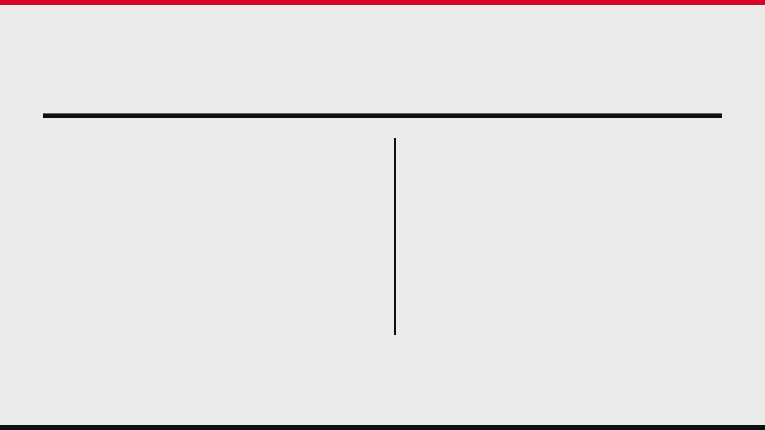
02 / MEMBERSHIP CHANGE
THE PREMIER LEAGUE’S MEMBERSHIP HAS CHANGED
↑
INCOMING FROM CHAMPIONSHIP
↓
OUTGOING TO CHAMPIONSHIP
PROMOTED
RELEGATED
Coventry City
Wolverhampton Wanderers
Ipswich Town
Burnley
Hull City
West Ham United
RETURN CONTEXT
Coventry last played in the Premier League in 2000/01. Hull return after a decade outside the top flight. Ipswich make an immediate return after a second-place Championship finish.
Source: Premier League, 5 Jun / 17 Jun 2026 [1][4]

Slide 4
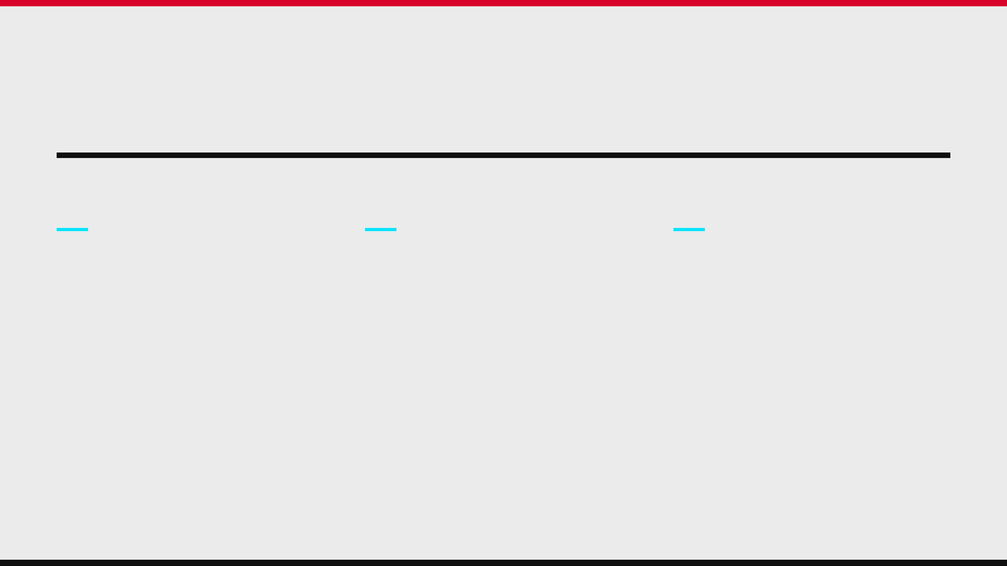
03 / PROMOTED PROFILES
THREE PROMOTED TEAMS ARRIVE WITH DISTINCT STORIES
COVENTRY CITY
IPSWICH TOWN
HULL CITY
CHAMPIONSHIP WINNERS
IMMEDIATE RETURN
PLAY-OFF WINNERS
Frank Lampard’s side return as
An immediate return brings a new
The play-off winners combine
Championship winners. Their summer
head coach, Gary O’Neil, plus a
leadership and international
adds defensive experience and
broad reinforcement drive featuring
experience, adding Konstantinos
emerging talent, led by Aurele
Daizen Maeda, Abdul Fatawu and
Tzolakis, Matt Targett, Jack Butland
Amenda and Caleb Yirenkyi.
Florentino Luis.
and Hidemasa Morita.
Source: Premier League, 5 Aug / 14 Aug 2026 [2][3]

Slide 5
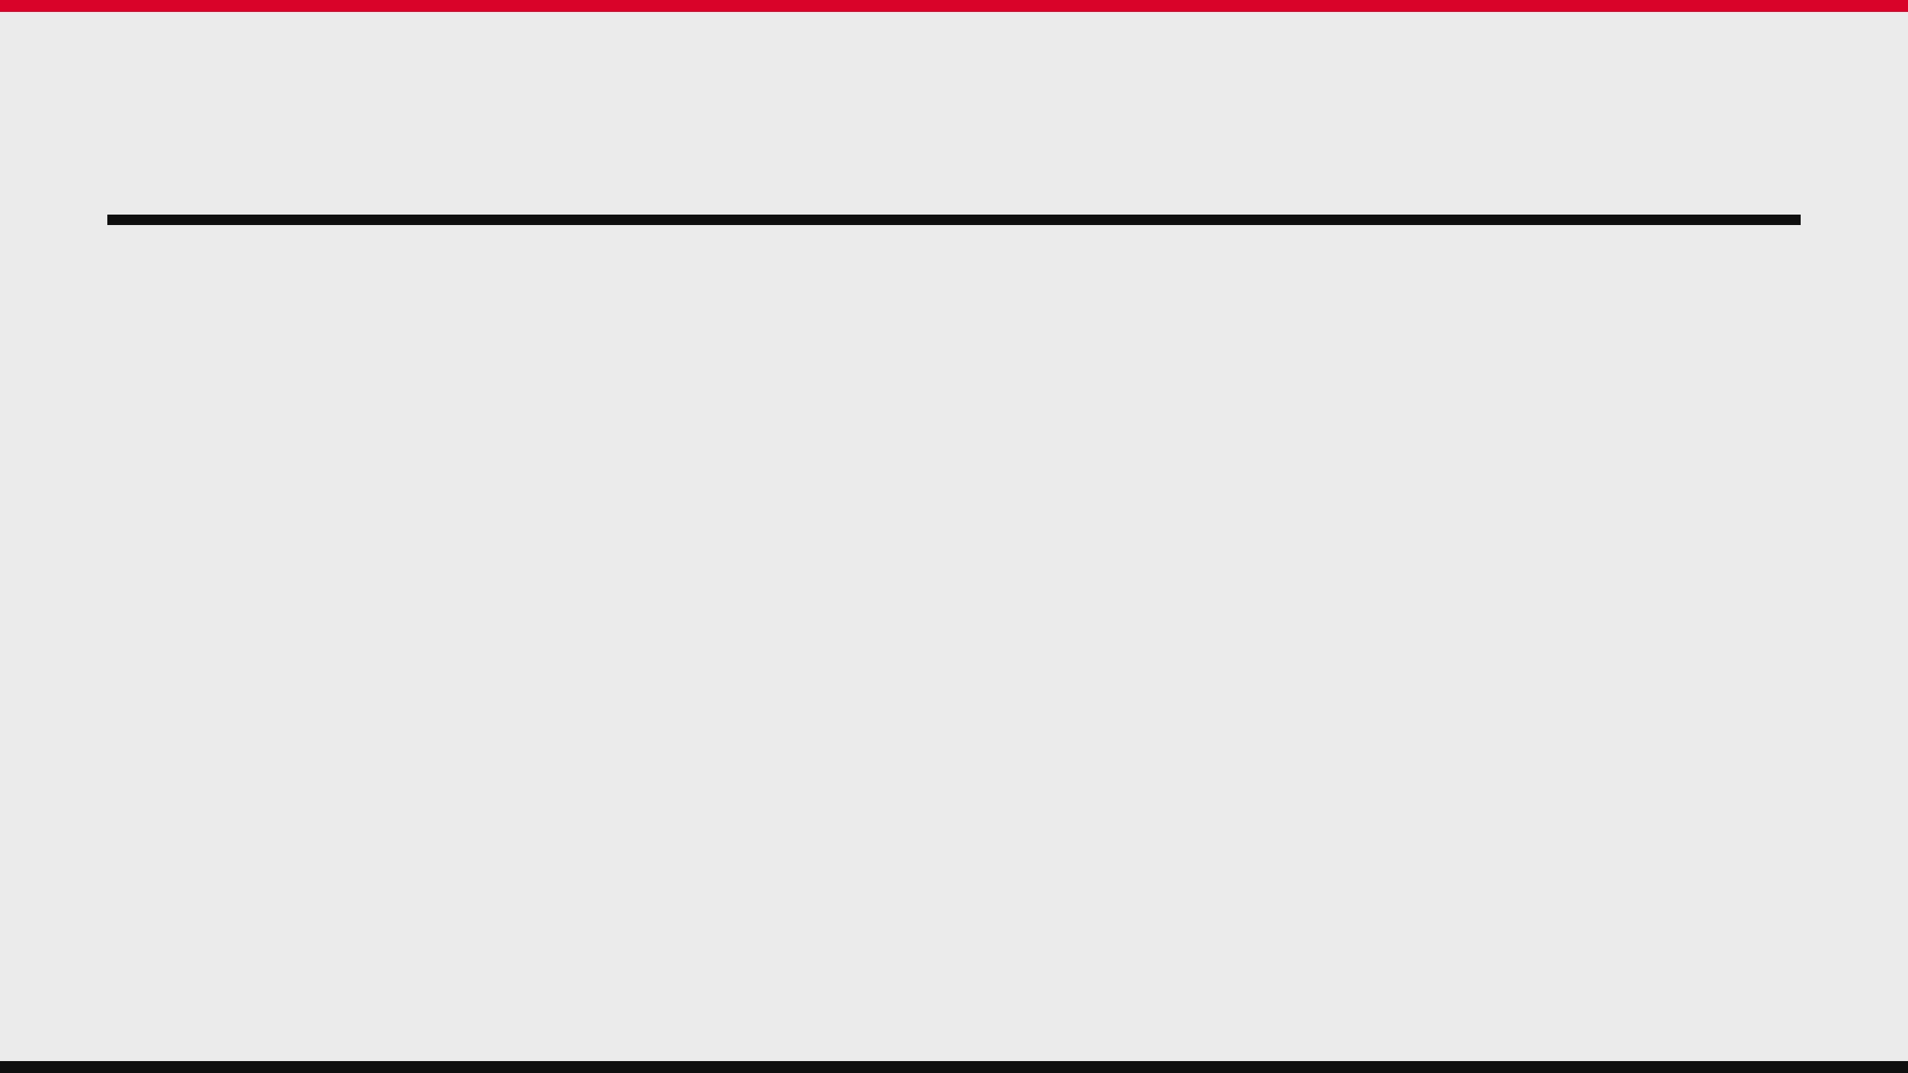
04 / MANAGER RESETS
NINE CLUBS BEGIN WITH A NEW MANAGER
TOP-SIX RESETS
NEW STRATEGIC DIRECTION
NEW CLUB CONTEXT
CHELSEA
BOURNEMOUTH
IPSWICH TOWN
Xabi Alonso
Marco Rose
Gary O’Neil
LIVERPOOL
CRYSTAL PALACE
NEWCASTLE UNITED
Andoni Iraola
Pierre Sage
Matthias Jaissle
MANCHESTER CITY
FULHAM
NOTTINGHAM FOREST
Enzo Maresca
Alvaro Arbeloa
Oliver Glasner
Source: Premier League, 5 Aug 2026 [2]

Slide 6
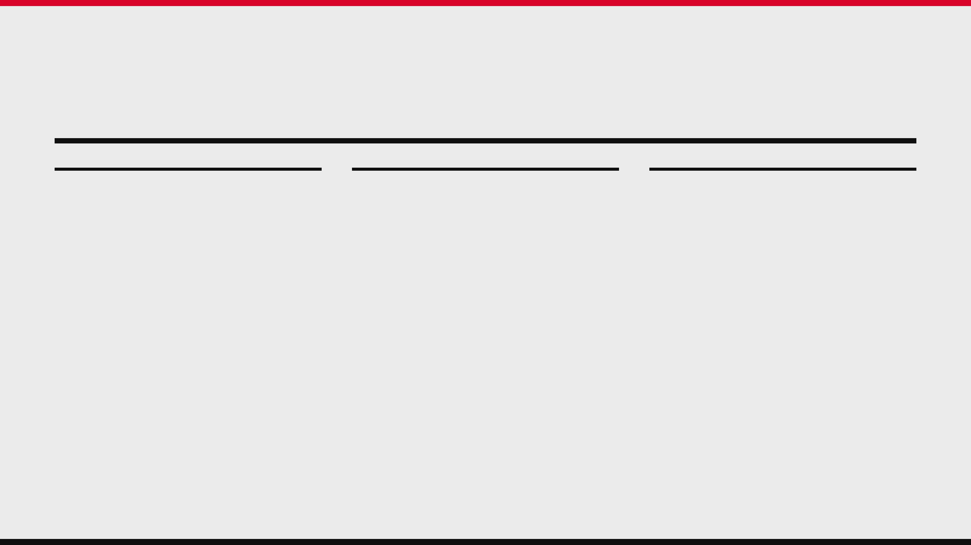
05 / TOP-SIX SUCCESSION
THE DEFINING SUCCESSION STORY SITS IN MANCHESTER
MANCHESTER CITY
LIVERPOOL
CHELSEA
ENZO MARESCA
ANDONI IRAOLA
XABI ALONSO
SUCCEEDS PEP GUARDIOLA, ENDING
TAKES OVER FROM ARNE SLOT TO
BEGINS HIS TENURE WITH A MANDATE
THE LEAGUE'S LONGEST-RUNNING
LEAD THE POST-KLOPP TRANSITION.
TO RESHAPE THE SQUAD'S TACTICAL
MANAGERIAL ERA.
IDENTITY.
INCOMING
INCOMING
Jeremy Jacquet is the headline incoming
INCOMING CORE
Elliot Anderson arrives from Nottingham
centre-back.
Morgan Rogers, Geovany Quenda, Marco
Forest.
Palestra, Maxence Lacroix and Emmanuel
OUTGOING CORE
Emegha added to reshape the squad.
OUTGOING CORE
Mohamed Salah, Andy Robertson and
The senior squad loses Bernardo Silva,
Ibrahima Konate depart Anfield.
John Stones, Manuel Akanji and Nathan
Ake.
Source: Premier League, 5 Aug / 14 Aug / 17 Jun 2026 [2][3][4]

Slide 7

06 / PLAYER MOVEMENT
PLAYER MOVEMENT IS ALTERING THE COMPETITIVE MAP
NEWCASTLE
→
ARSENAL
NEWCASTLE
→
TOTTENHAM
ASTON VILLA
↔
CHELSEA / MAN UTD
GUIMARAES DEPARTS
TONALI MOVES ON
MULTI-WAY EXCHANGE
Bruno Guimaraes joins Arsenal,
Sandro Tonali is part of a fast
Morgan Rogers moves to Chelsea;
while Newcastle replace key
Tottenham rebuild under Roberto
Youri Tielemans joins Manchester
outgoing midfield and attacking
De Zerbi, alongside Mateus
United; Alejandro Garnacho moves
pieces with Aladji Bamba,
Fernandes, Jan Paul van Hecke,
the other way to Villa on an
Bazoumana Toure and emerging
Marcos Senesi and Andy Robertson.
initial loan with an obligation
talent Sean Steur.
to buy.
Source: Premier League, 14 Aug / 17 Jun 2026 [3][4]

Slide 8
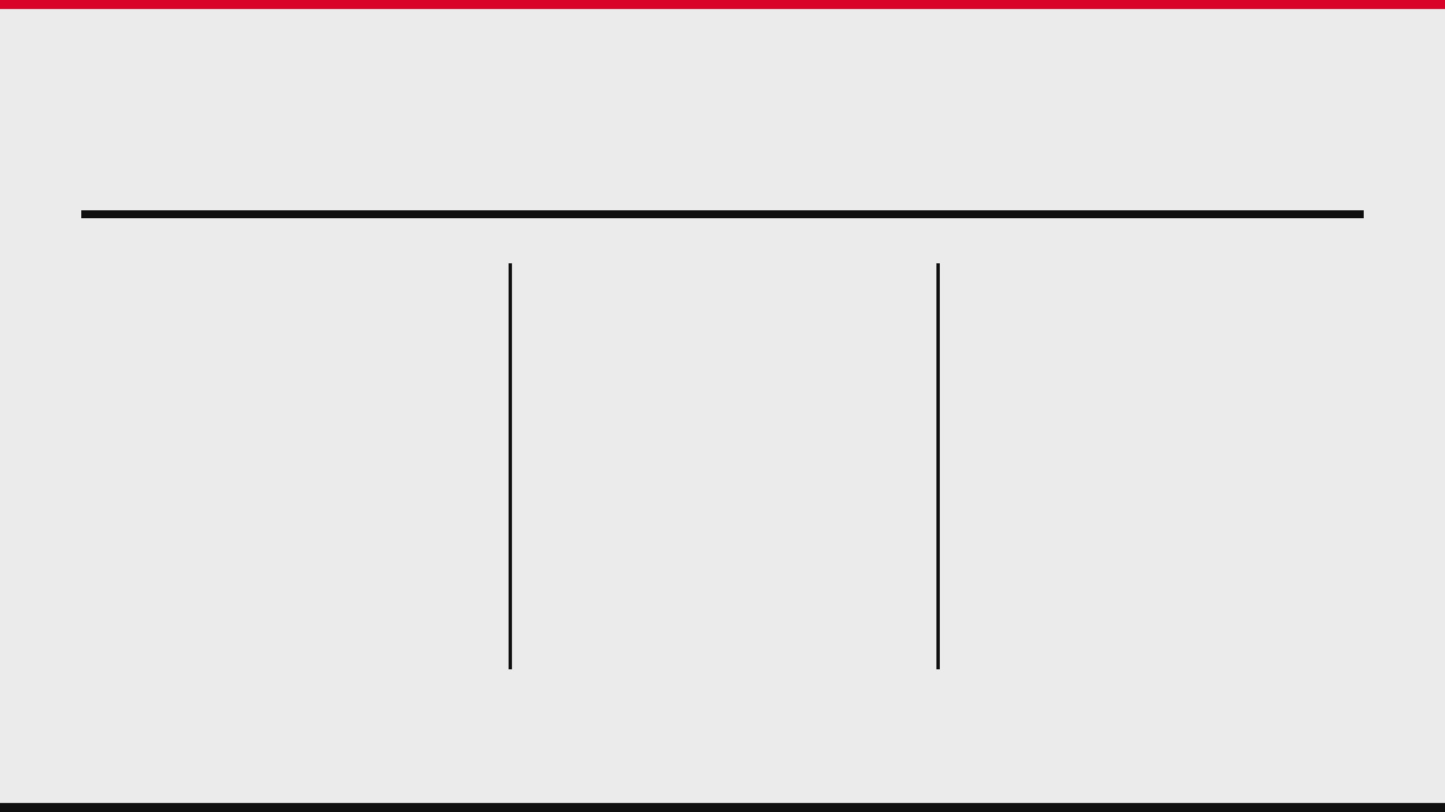
07 / PROMOTED RECRUITMENT
PROMOTED CLUBS ARE BUYING READINESS, NOT JUST NUMBERS
COVENTRY CITY
IPSWICH TOWN
HULL CITY
PREMIER LEAGUE-READY SPINE
SCALE AND EXPERIENCE
LEADERSHIP & PROTECTION
Amenda brings Champions League experience; Onyeka and Rushworth’s loans become permanent; Tchaouna adds top-flight familiarity.
Maeda brings end-product, while Diop, Florentino Luis and Sasa Lukic add established experience through the centre of the pitch.
Tzolakis replaces the outgoing first-choice goalkeeper; Targett and Butland bring 251 combined Premier League appearances; Morita adds international pedigree.
Source: Premier League, 14 Aug 2026 [3]

Slide 9
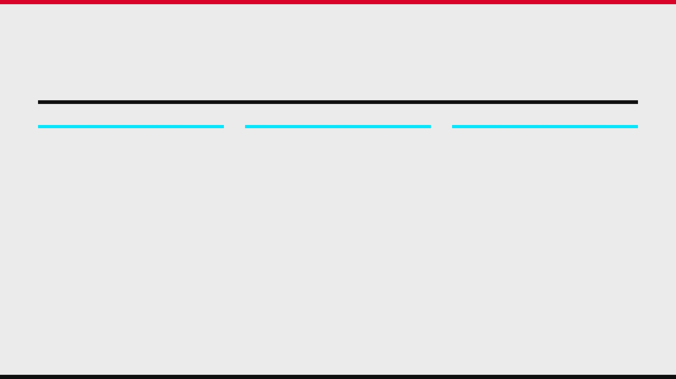
08 / ERA CHANGE
THE TRANSFER WINDOW IS AN ERA-CHANGE WINDOW
ENDINGS
SUCCESSIONS
COMPETITIVE EFFECT
Pep Guardiola departs Manchester City; Salah and Robertson leave Liverpool; Newcastle lose Guimaraes, Tonali and Anthony Gordon.
Maresca at City, Iraola at Liverpool and Jaissle at Newcastle are tasked with reshaping the football identity as well as the squad.
The largest changes concentrate among established contenders and clubs with new managers—not merely among the promoted sides.
Source: Premier League, 5 Aug / 14 Aug / 17 Jun 2026 [2][3][4]

Slide 10

09 / EXECUTIVE SUMMARY
THE CHANGE-ONLY BRIEF
NEW LEAGUE ENTRANTS
NEW DECISION-MAKERS
NEW SQUAD CORES
Coventry City, Ipswich Town and Hull City replace Wolves, Burnley and West Ham United.
Nine clubs begin the season with a newly appointed manager in the dugout.
Arsenal, Chelsea, Liverpool, Manchester City, Newcastle and Tottenham account for the most consequential structural movement highlighted in this briefing.
THIS IS A VERIFIED SNAPSHOT AS OF 18 AUGUST 2026. THE SUMMER TRANSFER WINDOW WAS STILL OPEN.
Source: Premier League, 5 Jun / 5 Aug / 14 Aug 2026 [1][2][3]

Slide 11

10 / REFERENCES
SOURCES AND SCOPE
[1]
Premier League. “The 2026/27 Premier League season officially starts!” 5 June 2026.
https://www.premierleague.com/en/news/4673099/the-202627-premier-league-season-officially-starts/
[2]
Premier League. “Manager line-up complete for 2026/27 season.” 5 August 2026.
https://www.premierleague.com/en/news/4679012/manager-line-up-complete-for-202627-season
[3]
Premier League. “Every Premier League club’s biggest deals in summer transfer window.” 14 August 2026.
https://www.premierleague.com/en/news/4681361/every-premier-league-clubs-biggest-deals-in-summer-transfer-window/
[4]
Premier League. “EIGHT reasons to be excited about the 2026/27 season.” 17 June 2026.
https://www.premierleague.com/en/news/4671538/eight-reasons-to-be-excited-about-the-202627-season/
SCOPE & METHODOLOGY
Confirmed or officially reported changes only, current to 18 August 2026. Transfer activity can change before the window closes. This briefing excludes match results, predictions, and routine squad turnover.

