Slide 1
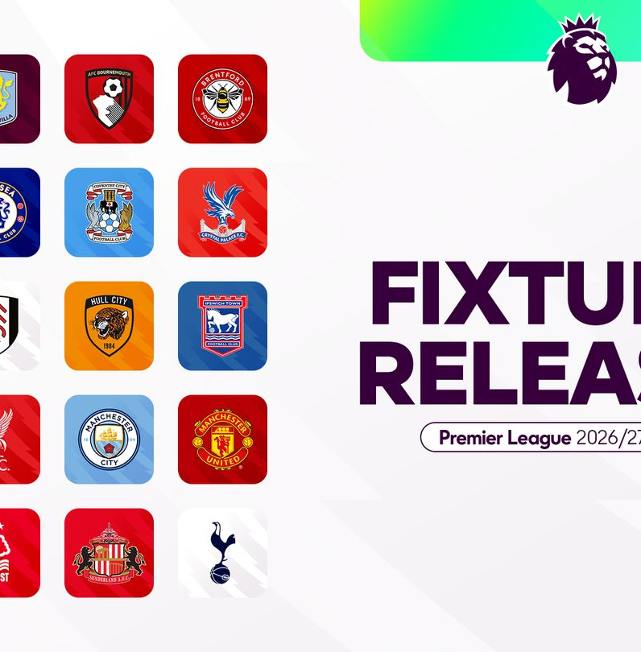
ENGLISH PREMIER LEAGUE
Opening weekend
starts here
2026/27 season preview • 21–24 August 2026
New players | New managers | Promoted clubs | Predictions
01
Notes:
[Sources]
- https://www.premierleague.com/en/news/4675097/all-380-fixtures-for-202627-premier-league-season
[/Sources]

Slide 2
2026/27 PREMIER LEAGUE
A season of change begins on Friday night
Champions Arsenal open the campaign at home to promoted Coventry City — the first of ten matches across four days.
10
3
9
OPENING-WEEKEND MATCHES
PROMOTED CLUBS
NEW MANAGERS
02
Notes:
[Sources]
- https://www.premierleague.com/en/news/4675097/all-380-fixtures-for-202627-premier-league-season
- https://www.premierleague.com/en/news/4679012/manager-line-up-complete-for-202627-season
- https://www.premierleague.com/en/news/4671538/eight-reasons-to-be-excited-about-the-202627-season
[/Sources]

Slide 3
2026/27 PREMIER LEAGUE
Three promoted clubs bring three very different stories
COVENTRY CITY
HULL CITY
IPSWICH TOWN
Championship winners return to the Premier League for the first time since 2000/01. Frank Lampard’s reward: Arsenal away on opening night.
Back in the top flight after a decade away. Sergej Jakirovic’s playoff winners start at home against Manchester United.
An immediate return after winning promotion under Kieran McKenna. New boss Gary O’Neil begins with Sunderland at Portman Road.
Opening-weekend reality
All three begin at home or on the season’s opening stage — an early chance to turn promotion energy into points.
03
Notes:
[Sources]
- https://www.premierleague.com/en/news/4675097/all-380-fixtures-for-202627-premier-league-season
- https://www.premierleague.com/en/news/4679012/manager-line-up-complete-for-202627-season
- https://www.premierleague.com/en/news/4671538/eight-reasons-to-be-excited-about-the-202627-season
[/Sources]

Slide 4
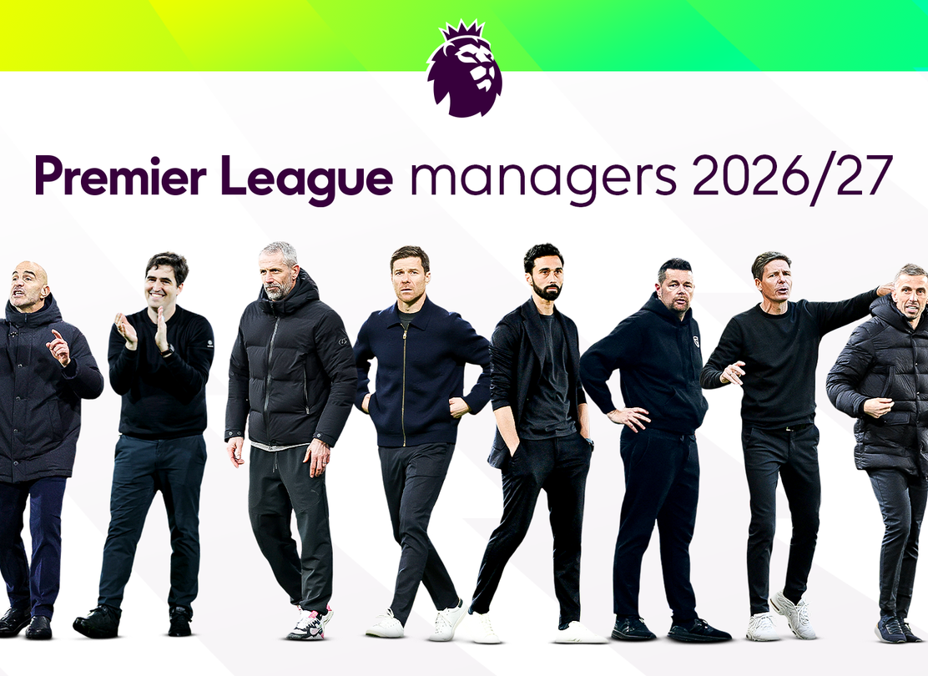
2026/27 PREMIER LEAGUE
Nine clubs start with a new voice in the dugout
Bournemouth
Marco Rose
Chelsea
Xabi Alonso
Crystal Palace
Pierre Sage
Fulham
Álvaro Arbeloa
Ipswich
Gary O’Neil
Liverpool
Andoni Iraola
Man City
Enzo Maresca
Newcastle
Matthias Jaissle
Nott’m Forest
Oliver Glasner
04
Notes:
The official Premier League manager line-up identifies nine clubs beginning 2026/27 under a manager appointed since the end of the previous campaign or during the summer.
[Sources]
- https://www.premierleague.com/en/news/4679012/manager-line-up-complete-for-202627-season
[/Sources]

Slide 5

2026/27 PREMIER LEAGUE
The biggest moves reshape the title race
Bruno Guimarães → Arsenal
Elliot Anderson → Man City
A proven tempo-controller joins Declan Rice at the defending champions.
England’s World Cup standout becomes the centrepiece of City’s midfield refresh.
Morgan Rogers → Chelsea
Sandro Tonali → Spurs
Xabi Alonso adds a dynamic England attacker alongside Cole Palmer.
A statement midfield signing for Roberto De Zerbi’s rebuild.
05
Notes:
[Sources]
- https://www.premierleague.com/en/news/4687721/vote-best-signing-ahead-of-202627
[/Sources]

Slide 6
2026/27 PREMIER LEAGUE
Eight more newcomers could change the league’s balance
Victor Muñoz
Youri Tielemans
Andrey Santos
João Gomes
Liverpool
Man Utd
Man Utd
Aston Villa
Wide attacker; arrives after Salah’s departure
Experience and control for Carrick’s midfield
Ball-winning partner with long-term upside
Energy and defensive balance for Emery
Antonio Silva
Ousmane Diomande
Gonzalo García
Harry Wilson
Bournemouth
Nott’m Forest
Fulham
Leeds
Young, Champions League-tested centre-back
Title-winning defender from Sporting
Real Madrid forward reunited with Arbeloa
11-goal creator signed on a free transfer
06
Notes:
[Sources]
- https://www.premierleague.com/en/news/4687721/vote-best-signing-ahead-of-202627
[/Sources]

Slide 7
2026/27 PREMIER LEAGUE
Friday and Saturday put every promoted club on stage
KICK-OFF | HOME | AWAY | UK COVERAGE
FRI 21 AUG · 20:00 | Arsenal | Coventry City | Sky Sports
SAT 22 AUG · 12:30 | Hull City | Manchester United | TNT Sports
SAT 22 AUG · 15:00 | Everton | Crystal Palace | —
SAT 22 AUG · 15:00 | Ipswich Town | Sunderland | —
SAT 22 AUG · 15:00 | Nottingham Forest | Leeds United | —
SAT 22 AUG · 17:30 | Brentford | Tottenham Hotspur | Sky Sports
07
Notes:
[Sources]
- https://www.premierleague.com/en/news/4675097/all-380-fixtures-for-202627-premier-league-season
[/Sources]

Slide 8

2026/27 PREMIER LEAGUE
Sunday’s heavyweight clash leads into a west-London finale
KICK-OFF | HOME | AWAY | TV
SUN 23 AUG · 14:00 | Brighton | Aston Villa | Sky Sports
SUN 23 AUG · 14:00 | Manchester City | Bournemouth | Sky Sports
SUN 23 AUG · 16:30 | Newcastle United | Liverpool | Sky Sports
MON 24 AUG · 20:00 | Fulham | Chelsea | Sky Sports
Match of the weekend
Newcastle v Liverpool
08
Notes:
[Sources]
- https://www.premierleague.com/en/news/4675097/all-380-fixtures-for-202627-premier-league-season
- https://www.premierleague.com/en/news/4606700/premier-league-clubs-2026-pre-season-fixtures-and-results
[/Sources]

Slide 9
EDITORIAL PREDICTIONS · MODERATE UNCERTAINTY
Opening-weekend predictions: champions start fast
Arsenal
v
Coventry
2–0
Brentford
v
Spurs
1–2
Hull
v
Man Utd
1–2
Brighton
v
Aston Villa
1–1
Everton
v
Crystal Palace
1–1
Man City
v
Bournemouth
2–1
Ipswich
v
Sunderland
1–1
Newcastle
v
Liverpool
1–2
Nott’m Forest
v
Leeds
2–1
Fulham
v
Chelsea
1–2
Predictions are provisional judgements based on squad strength, home advantage, managerial transition and recent pre-season context — not betting guarantees.
09
Notes:
[Sources]
- https://www.premierleague.com/en/news/4675097/all-380-fixtures-for-202627-premier-league-season
- https://www.premierleague.com/en/news/4679012/manager-line-up-complete-for-202627-season
- https://www.premierleague.com/en/news/4687721/vote-best-signing-ahead-of-202627
- https://www.premierleague.com/en/news/4606700/premier-league-clubs-2026-pre-season-fixtures-and-results
[/Sources]

Slide 10
THE WEEKEND’S FOUR QUESTIONS
Who lands the first blow?
01
Can Arsenal carry championship authority into a new campaign?
02
Will the promoted clubs turn home energy into early points?
03
Which new manager makes the clearest tactical statement?
04
Which major signing looks immediately at home?
Premier League 2026/27 • Opening weekend: 21–24 August
10
Notes:
[Sources]
- https://www.premierleague.com/en/news/4675097/all-380-fixtures-for-202627-premier-league-season
- https://www.premierleague.com/en/news/4679012/manager-line-up-complete-for-202627-season
- https://www.premierleague.com/en/news/4687721/vote-best-signing-ahead-of-202627
[/Sources]

